Slide 1
Object Oriented Programming using Java (ECSE102L)

Slide 2
Outline
Data Structure
Types of Data Structure
Linear Data Structure
Non-Linear Data Structure
Stack

Slide 3
Data Structure
S
In computer science, a data structure is a data organization that enables efficient access and modification.
It is a collection of data values, the relationships among them, and the functions or operations that can be applied to the data.

Slide 4
Types of Data Structure
S
Data Structure
Linear
Non-Linear
Array
Linked list
Stack
Queue
Tree
Graph

Slide 5
Linear Data Structure
S
Data elements are arranged sequentially or linearly.
Here, elements are linked to its previous and next adjacent elements i.e. linear data structure.
In linear data structure, single level is involved. So, we can traverse all the elements in single run only.
Linear data structures are easy to implement.
Here, computer memory is arranged in a linear way.

Slide 6
Non-Linear Data Structure
S
Data elements are not arranged sequentially or linearly.
In a non-linear data structure, single level is not involved. So, we can’t traverse all the elements in single run only.
It is difficult to implement in comparison to linear data structure.

Slide 7
Stack
S
A stack is a data structure of ordered items such that items can be inserted and removed only at one end known as Top.
The last element to be added is the first to be removed (LIFO: Last In First Out).
Only access to the top element.

Slide 8

Stack (Cont…)
S
Example:

Slide 9
Stack (Cont…)
S
Basic Operations:
  Push
    Push operation to place a new item at the top of the stack.
    Condition: Stack must not OVERFLOW.
  Pop
    Pop operation to remove the item from the top of the stack.
    Condition: Stack must not UNDERFLOW.

Slide 10
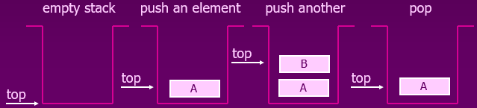
Stack (Cont…)
S
Basic Operations (Cont…):

Slide 11
Stack (Cont…)
S
Implementation of Stack
  Arrays
    Static: The size of the stack must assign at the beginning.
  Linked lists
    Dynamic: Never becomes full.

Slide 12
Stack (Cont…)
S
Implementation of Stack using Array:
Push(a, top, item, max)
If top=max
print ‘STACK OVERFLOW’
exit
else
top=top+1
a[top]=item
Exit

Slide 13
Stack (Cont…)
S
Implementation of Stack using Array (Cont…):
Pop(a, top, item)
If top=0
print ‘STACK UNDERFLOW’
exit
else
item=a[top]
top=top-1
Exit

Slide 14
Stack (Cont…)
S
Implementation of Stack using Array (Cont…):
Display(top, i, a)
If top=0
Print ‘STACK EMPTY’
Exit
Else
For i=top to 0
Print a[i]
Exit

Slide 15
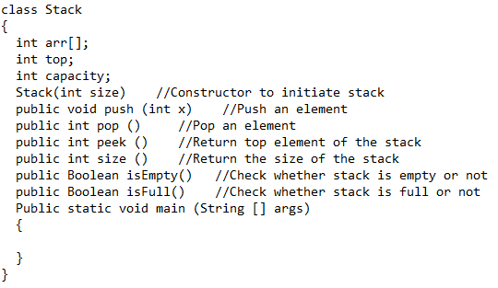
Stack (Cont…)
S
The Entire Structure of Implementation:

Slide 16
Stack (Cont…)
S
Application:
  Reversing a String.
      Read each letter of the String and push it onto the stack.
      When we will reach the last letter of the String, pop the letters off the stack and print them out.
  Checking validity of an expression
      The program for checking the validity of an expression verifies that for each left parenthesis braces or bracket, there is a corresponding closing symbol and symbols are appropriately nested.

Slide 17
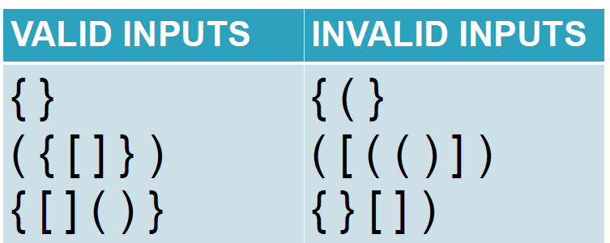
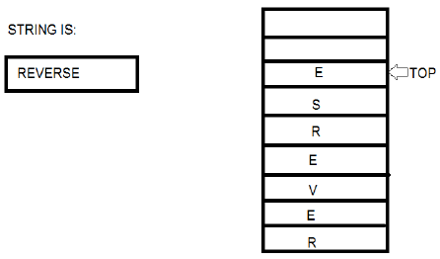
Stack (Cont…)
S
Application (Cont…):

Slide 18
Stack (Cont…)
S
Application (Cont…):
  Evaluating arithmetic expressions:
    Infix notation: The normal way of writing arithmetic expressions is known as infix notation.
(a-b)
    Prefix notation: Operator is before the operands.
-AB
    Postfix notation: Operator is after the operands.
AB-

Slide 19
Stack (Cont…)
S
Application (Cont…):
  Evaluating arithmetic expressions (Cont…):
  Find Postfix and Prefix of the following expression:
  A + B * C + D
  Find Postfix and Prefix of the following expression:
    (A+B)*C-(D-E)*(F+G)

Slide 20
Stack (Cont…)
S
Application (Cont…):
  Evaluating arithmetic expressions (Cont…):
  Find Postfix and Prefix of the following expression:
  A + B * C + D
  Postfix: ABC*+D+ Prefix: ++A*BCD
  Find Postfix and Prefix of the following expression:
    (A+B)*C-(D-E)*(F+G)
    Postfix: AB+C*DE-FG+*- Prefix: -*+ABC*-DE+FG

Slide 21
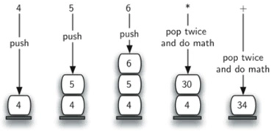
Stack (Cont…)
S
Application (Cont…):
  Evaluating arithmetic expressions (Cont…):
  Expression: 456*+

Slide 22
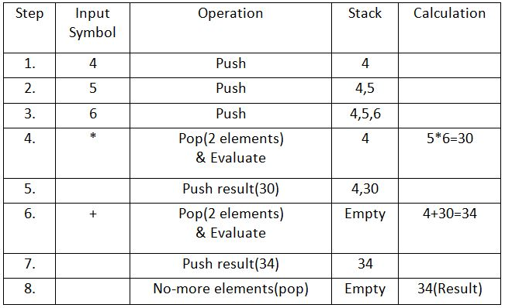
Stack (Cont…)
S
Application (Cont…):
  Evaluating arithmetic expressions (Cont…):
  Expression: 456*+

Slide 23
Stack (Cont…)
S
Application (Cont…):
  Evaluating arithmetic expressions (Cont…):
  Practice for the expression: +-927

Slide 24
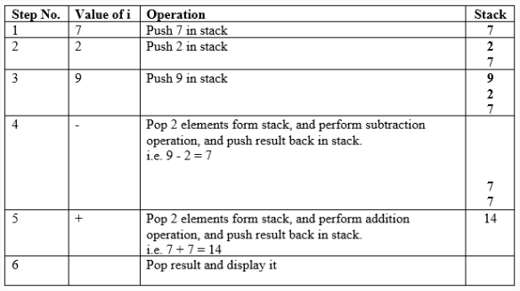
Stack (Cont…)
S
Application (Cont…):
  Evaluating arithmetic expressions (Cont…):
  Practice for the expression: +-927

Slide 25




